Slide 1

Cascading style sheets
Meaning: This is a style sheet language designed to control the presentation of markup language documents like HTML.
Style sheet are a collection of formatting rules.
Styles are mostly contained in external files that can control
a single document or the entire website.
The term cascade refers to how the styles are applied to pages.
Styles are applied in the order they are found ,cascading down from external to local styles.

Slide 2
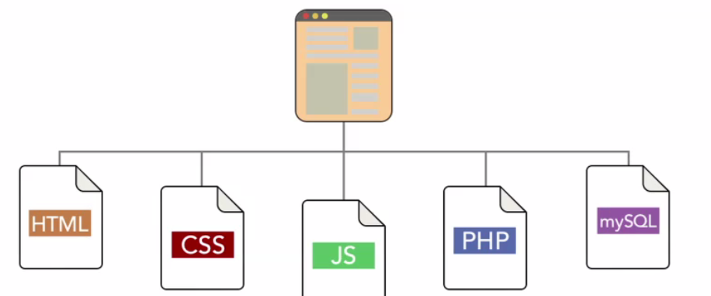
Modularised design of a website.

Slide 3
HTML:This controls the document structure
CSS:Controls the document look and feel
JavaScript: Controls the behaviour within the client or browser
PHP(server side language):Controls processing and business logic
MYSQL(database):Store content.

Slide 4
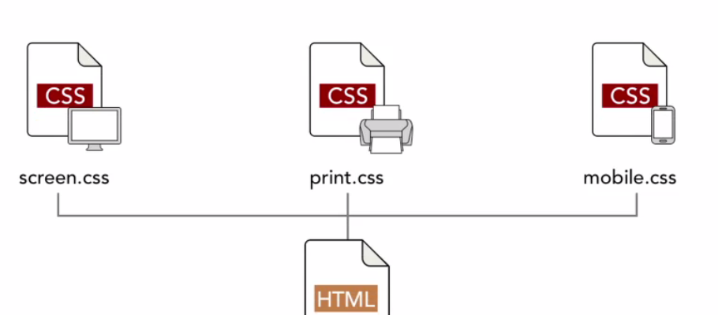
Separate styles for different media types

Slide 5
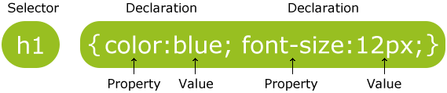
CSS Syntax
A CSS rule set consists of a selector and a declaration block:

Slide 6
The selector points to the HTML element you want to style.
The declaration block contains one or more declarations separated by semicolons.
Each declaration includes a property name and a value, separated by a colon.

Slide 7
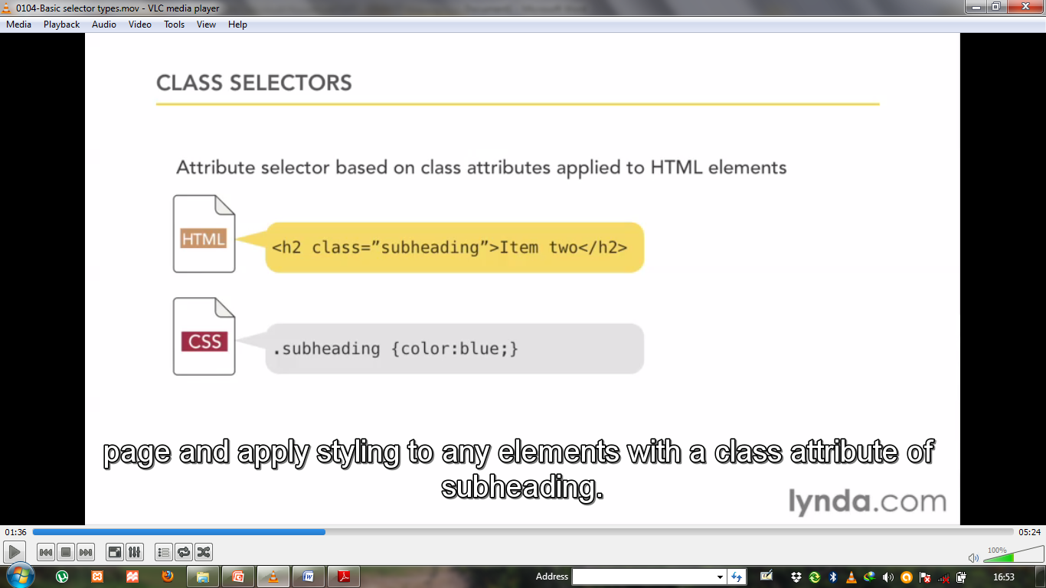
CLASS SELECTORS
Attribute selector based on class applied to HTML elements

Slide 8
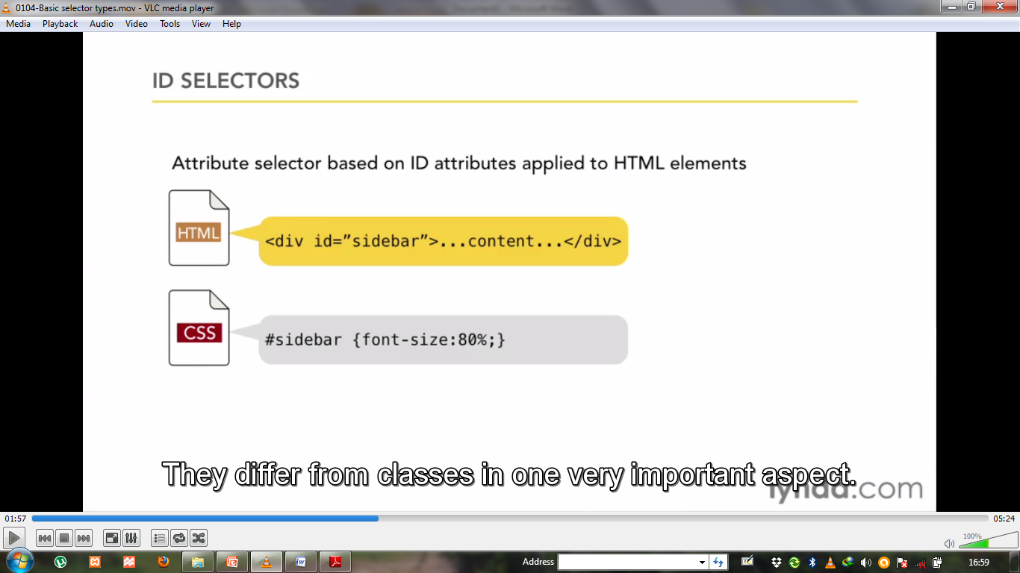
ID selectors
ID selectors are similar to class selectors in that they represent an HTML attribute.
IDs must be unique to the page meaning that if you assign an ID to a page element no other element on that page may have that specific ID.

Slide 9
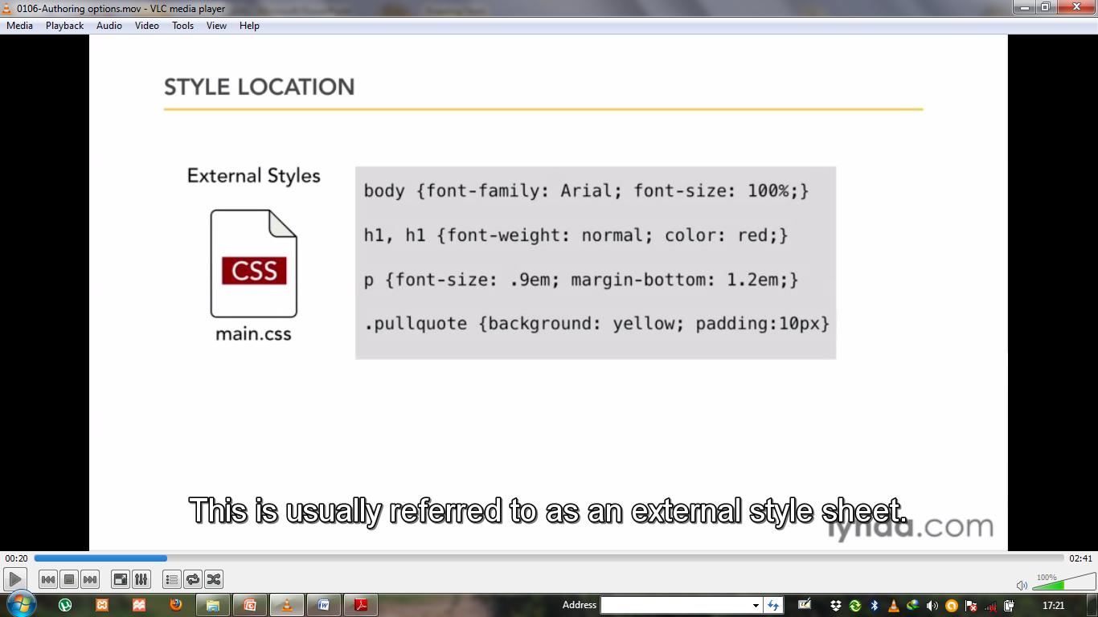
CSS Authoring
This is usually referred to us external styles.

Slide 10
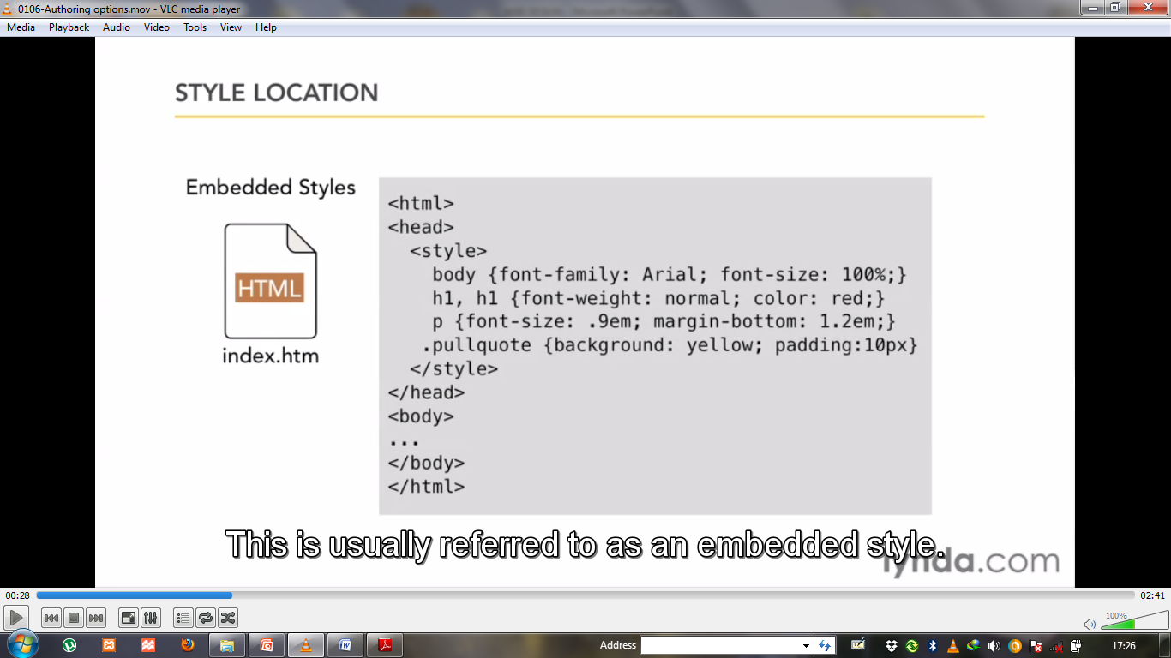
Style Location.
This is usually referred to us embedded style.

Slide 11
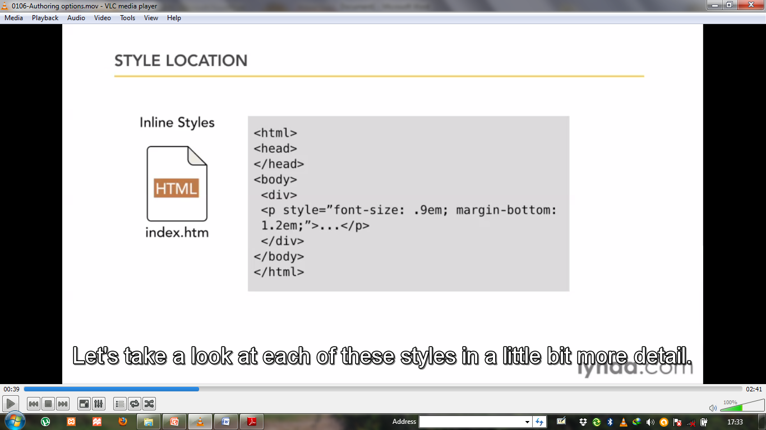
Style Location.
This is usually referred to us inline style.

Slide 12
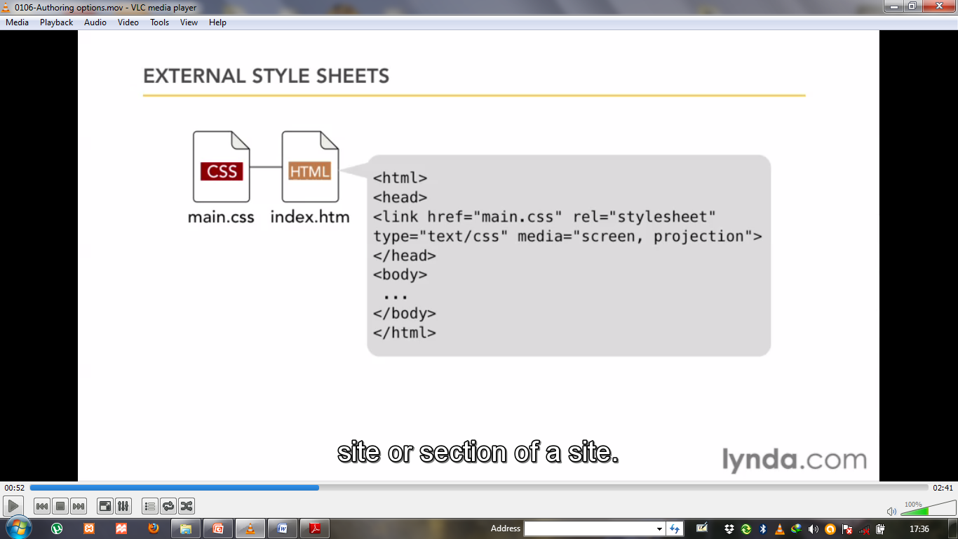
External style sheet
You apply this styles to pages by using a link tag in the head of a document. You can even specify the type of media you want to apply the styles to.

Slide 13
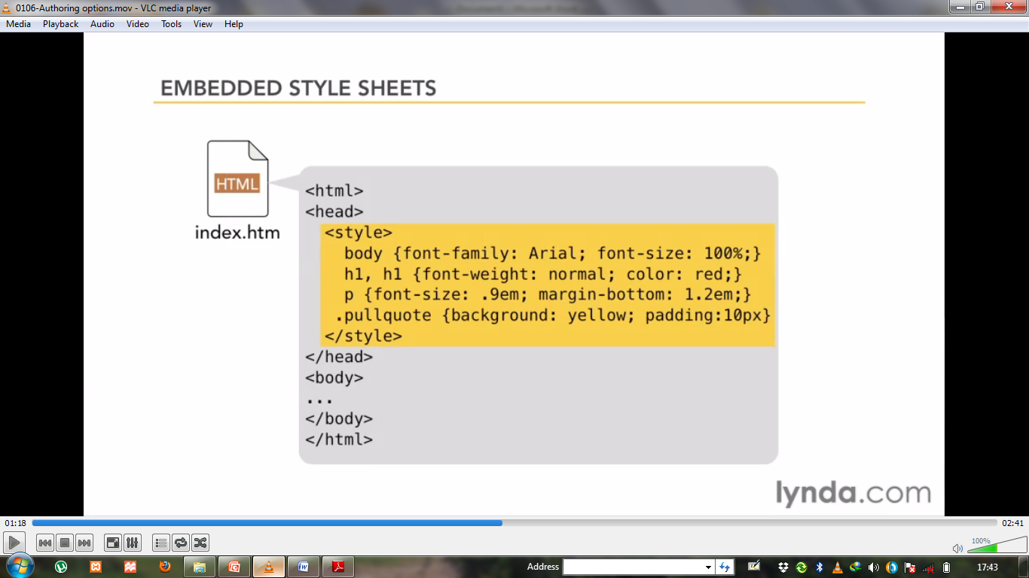
Embedded style
They are perfect for targeted styles that are specific to a certain page but inefficient for site wide changes.

Slide 14
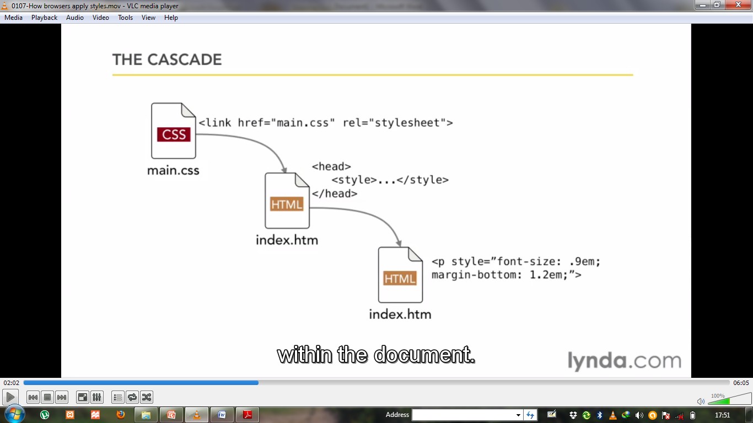
The Cascade Concept
The last rule applied wins.

Slide 15
Example illustration of applying the three css authoring

Slide 16
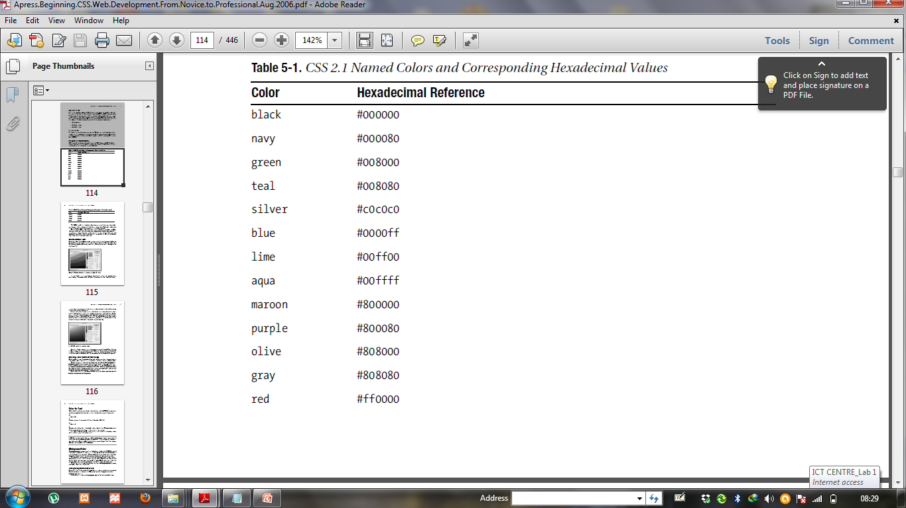
Colors and Hexadecimal reference

Slide 17
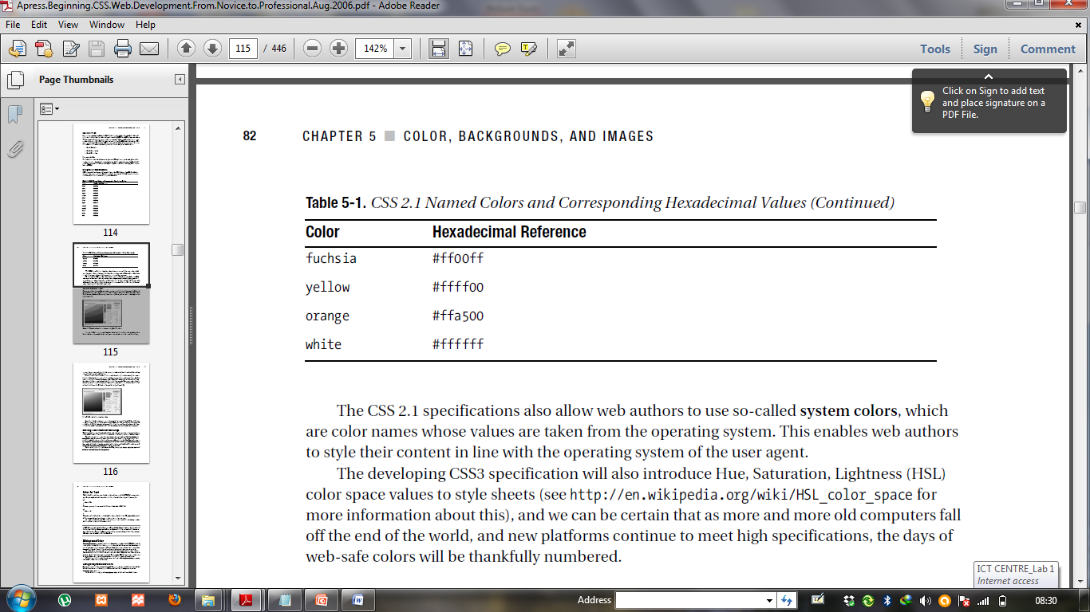
Colors and Hexadecimal reference

Slide 18
Common CSS Concepts
Working with fonts.
It is important to choose a font type for your website.
system fonts
widely supported
limited choices
web fonts
Emerging technique
lack of support in older browsers.

Slide 19
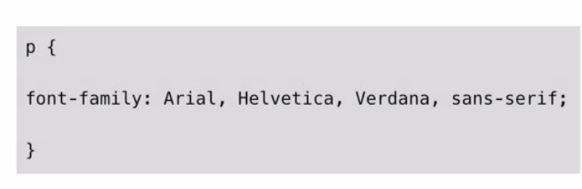
Requesting Font

Slide 20
CSS Font Options
Allow the browser to display its default font.
Specify a system font and provide fallback option
use@font-face to point to a hosted font resource.

Slide 21
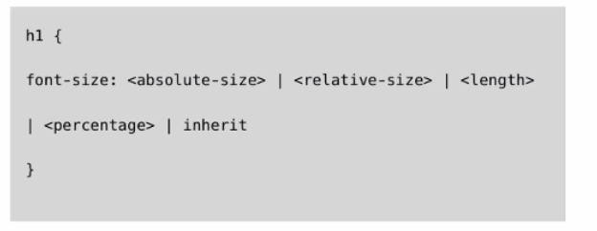
Defining Font Size

Slide 22
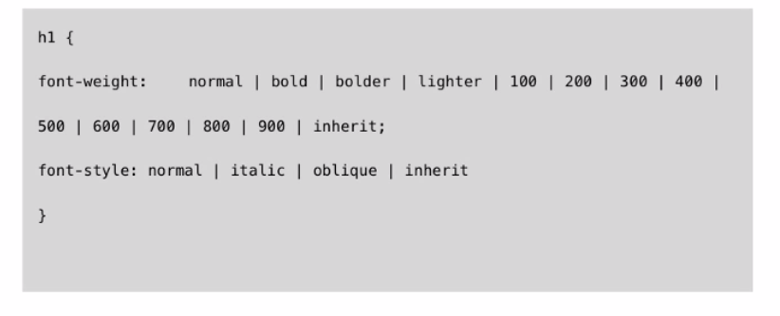
Font weight and style

Slide 23
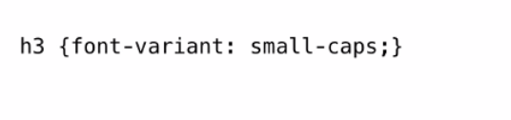
Font variant
Allows you to specify text in small caps or upper case

Slide 24
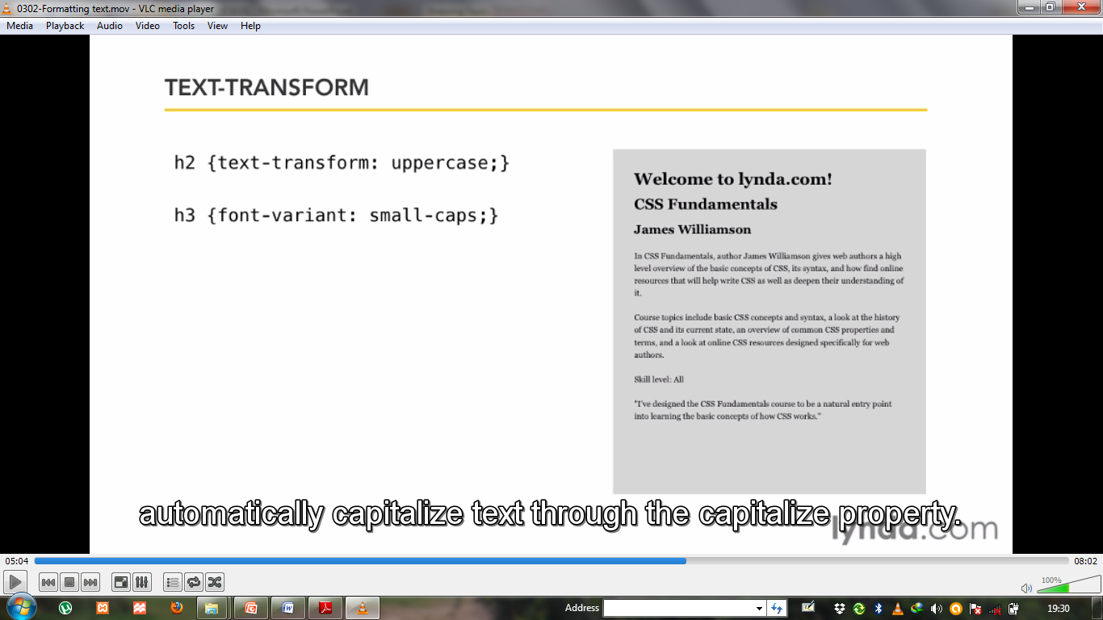
Text-Transform

Slide 25
The box Model
The box model refers to the physical properties of an element’s rectangular box.
This are margins,borders,padding and content width and height.
Every single element on your web page is considered to be a rectangular box.

Slide 26
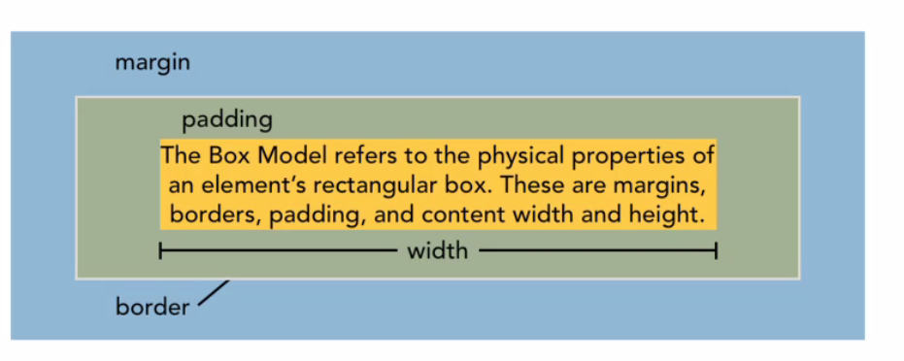
The box Model properties

Slide 27
The box Model properties
Margins represent the space around the element and are used to define the space btwn page elements.They are not used to calculate the final width of an element.
Borders have three properties that define the border itself: border –width, border-style and border-color.They define the outside edge of an element.
Padding this is a space added to an element inside the border.

Slide 28
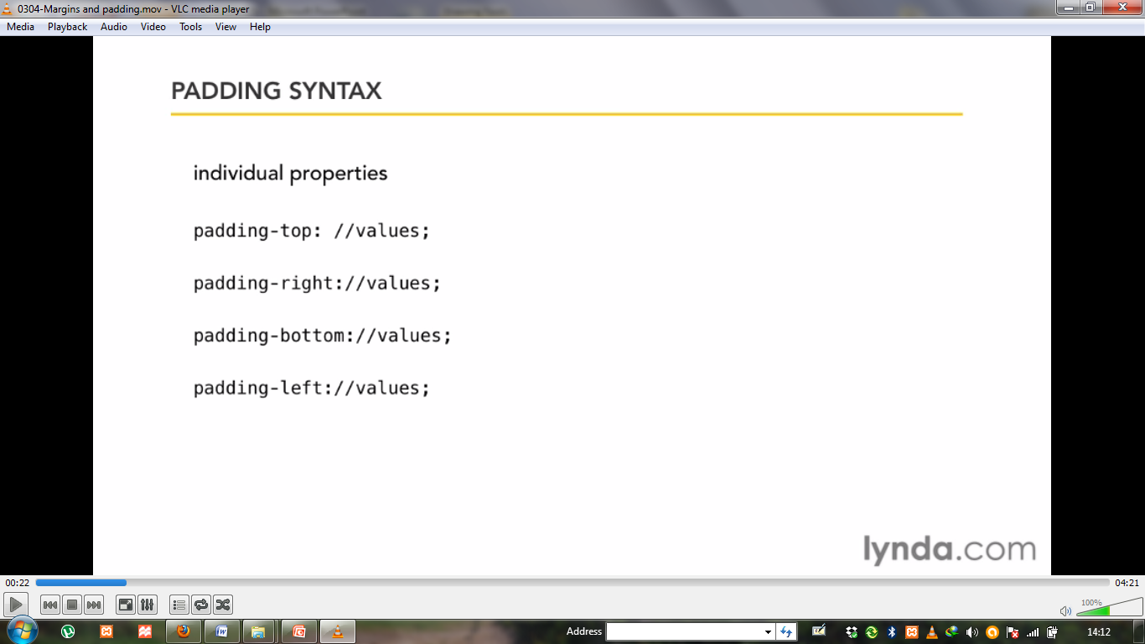
Padding syntax
You can define padding individually for each side of an element.

Slide 29
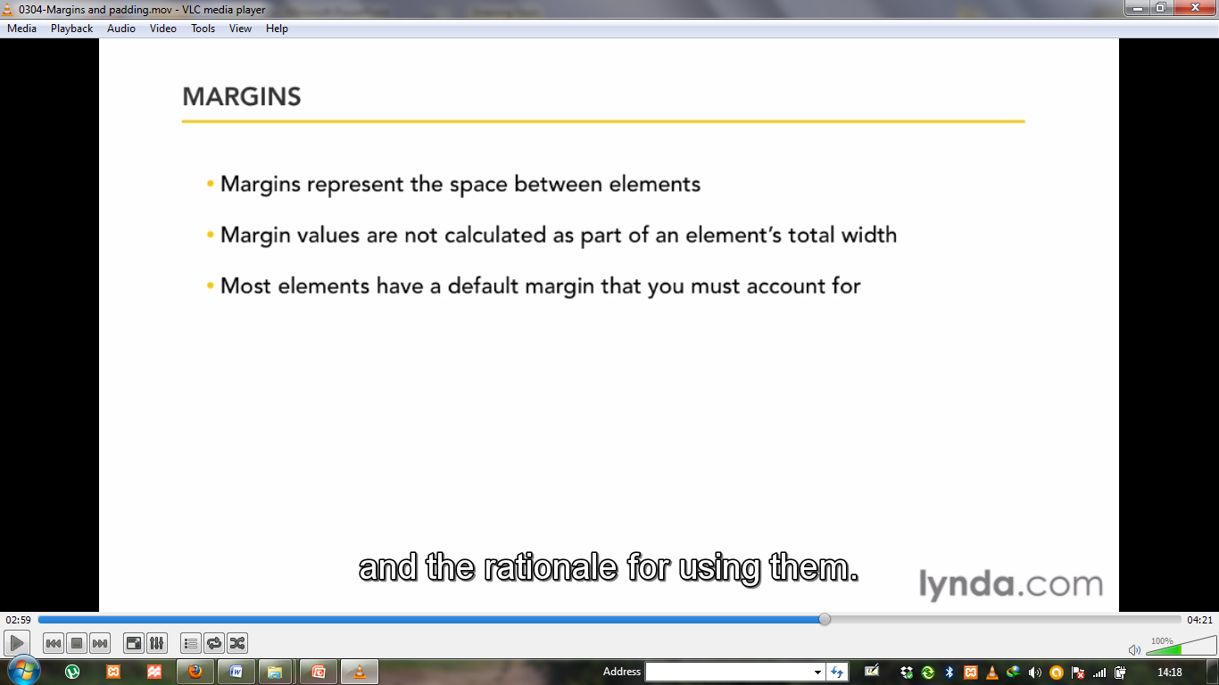
Margins

Slide 30
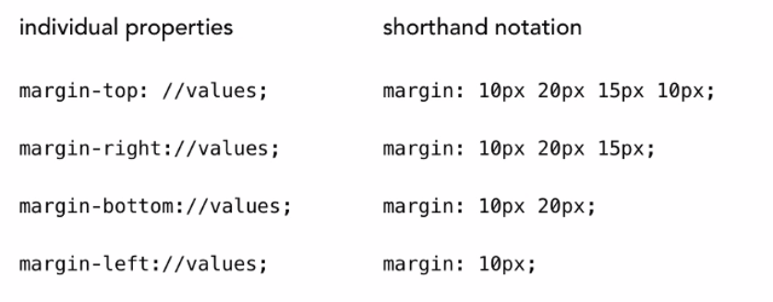
Margin Syntax

Slide 31
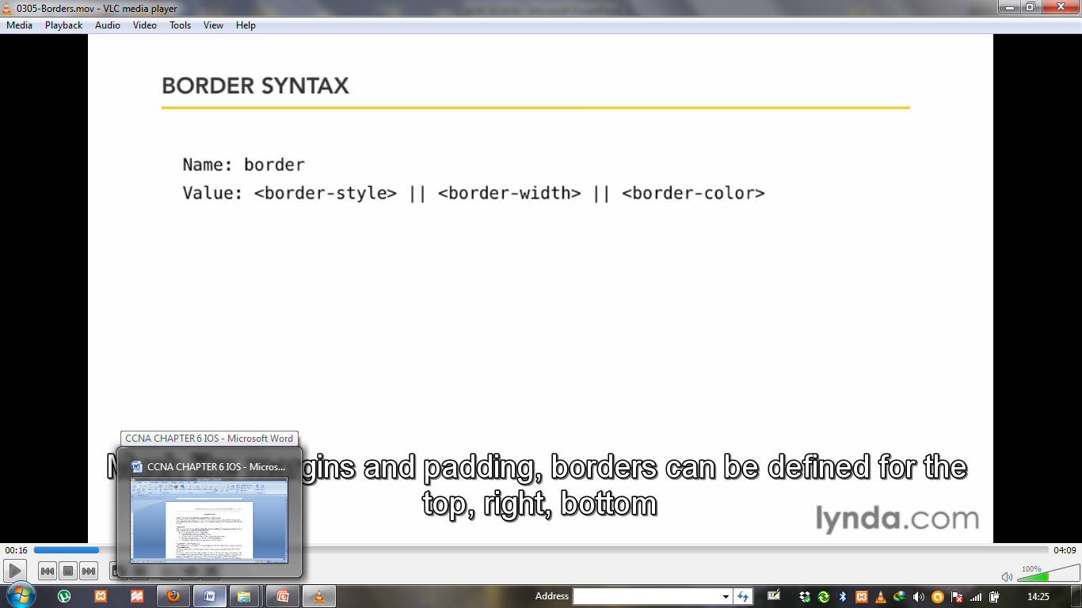
Border syntax

Slide 32
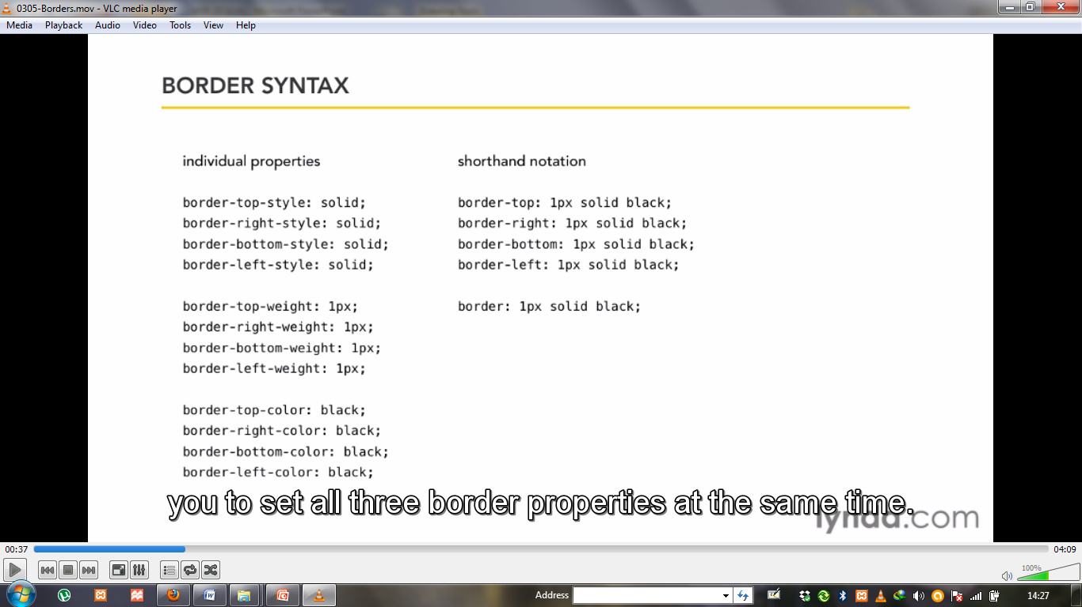
Border syntax

Slide 33
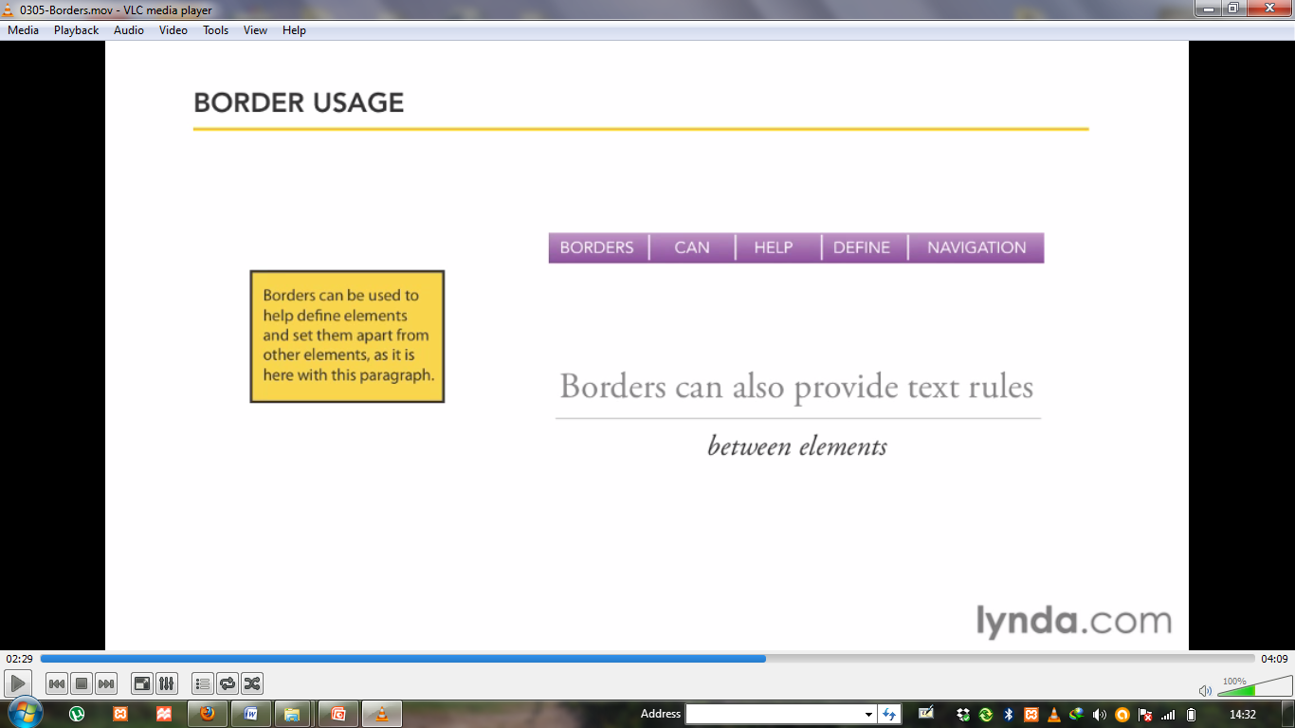
Border Usage

Slide 34
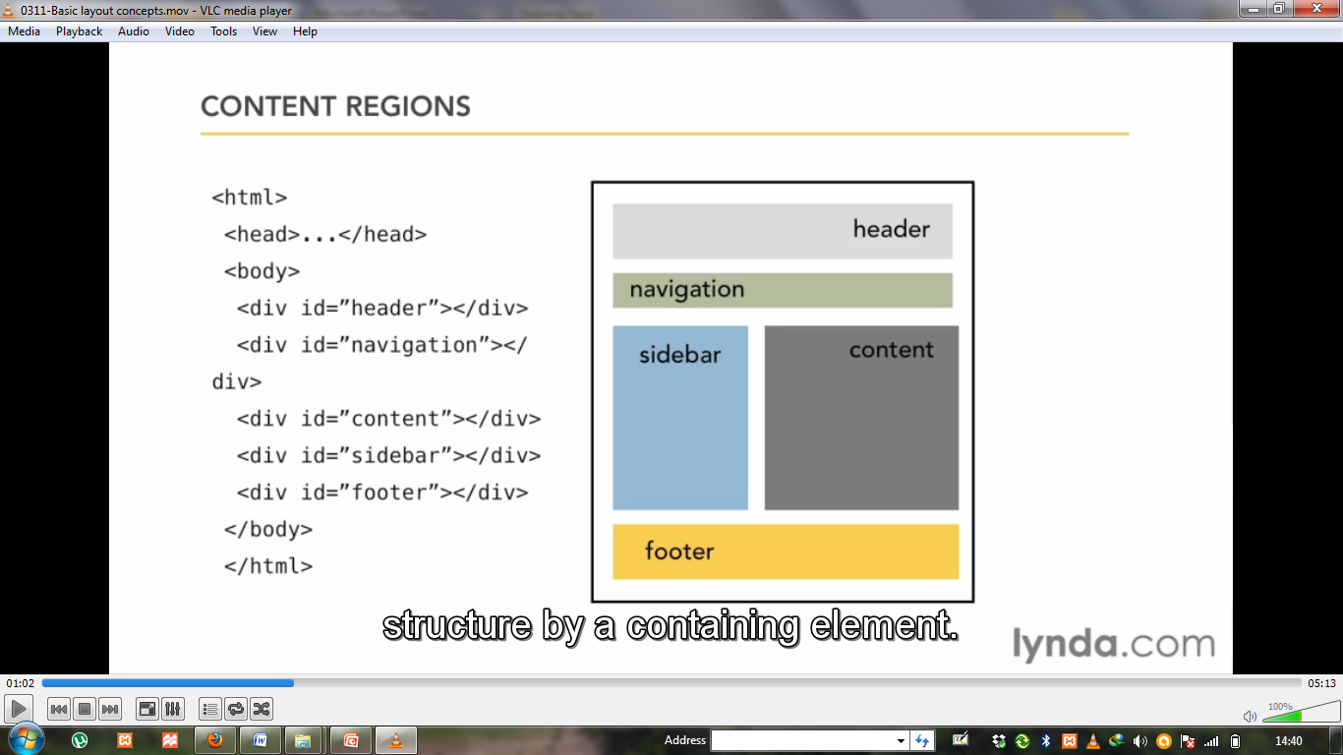
Basic layout

Slide 35
Use of lists in css
A list of items can be created in numerous ways using (X)HTML, although not all are semantically correct. The lazier methods include adding a <br /> tag after each item, or treating each item as a paragraph. The correct approach is to use an ordered or unordered list element, using simple <li> tags to open each item.
The major benefit of this approach is that your list will be displayed as a numbered or bulleted list without CSS, and is considerably easier to control with CSS. Using semantically
correct list markup also makes it easy to single out items within a list, and also makes nested lists easier to manage.

Slide 36
Grouping Items with Classes
Classes are especially useful when you wish to have control over a number of elements. In our two lists, there are clearly other groupings that can be defined

Slide 37
Navigation lists
A common feature of web sites built using web standards are navigation menus constructed using an unordered list. Using the <ul> element in this sense is semantically correct, with each destination link defined as an individual list item. This approach provides incredible flexibility, allowing the navigation list to be either horizontal or vertical as defined using CSS, and also allows for a seemingly unlimited number of styling approaches.

Slide 38
The Vertical Navigation Bar
A very common feature of many, many web sites is the vertical navigation bar created with
simple list mark-up. The goal here is to turn each list element into a button without using any images whatsoever.

Slide 39
Forms
Without forms, a web site generally works in only one direction.
Pages contain information and images, the user reads this
information or looks at the images, and that is that.
Forms allow the user to interact with the web site by exchanging
data.

Slide 40
Forms are used for a huge number of purposes, from fairly
Simple functions such as logging in to a web application,
leaving comments, and providing
Contact info, right up to enabling article entry, serving as
questionnaires, and allowing résumé uploads, and can exist on
onepage or be spread across several.

Slide 41
Forms are used for a huge number of purposes, from fairly
Simple functions such as logging in to a web application,
leaving comments, and providing
Contact info, right up to enabling article entry, serving as
questionnaires, and allowing résumé uploads, and can exist on
onepage or be spread across several.

